Slide 1


Software and Operating Systems
HANA ADEN

Slide 2
Defining Software and Its Importance
INSTRUCTIONS FOR HARDWARE
Software comprises instructions that enable hardware operation and are essential for making computers functional and interactive for users.
ESSENTIAL FOR FUNCTIONALITY
Without software, hardware remains inactive. It is crucial for managing tasks and providing users with helpful interfaces and applications.

Slide 3
Software Types Overview
SYSTEM SOFTWARE
System software manages hardware resources, providing essential support for application software and enabling overall operation of the computer system.
APPLICATION SOFTWARE
Application software allows users to perform specific tasks, enhancing productivity and user experience, but is not vital for system functionality.

Slide 4
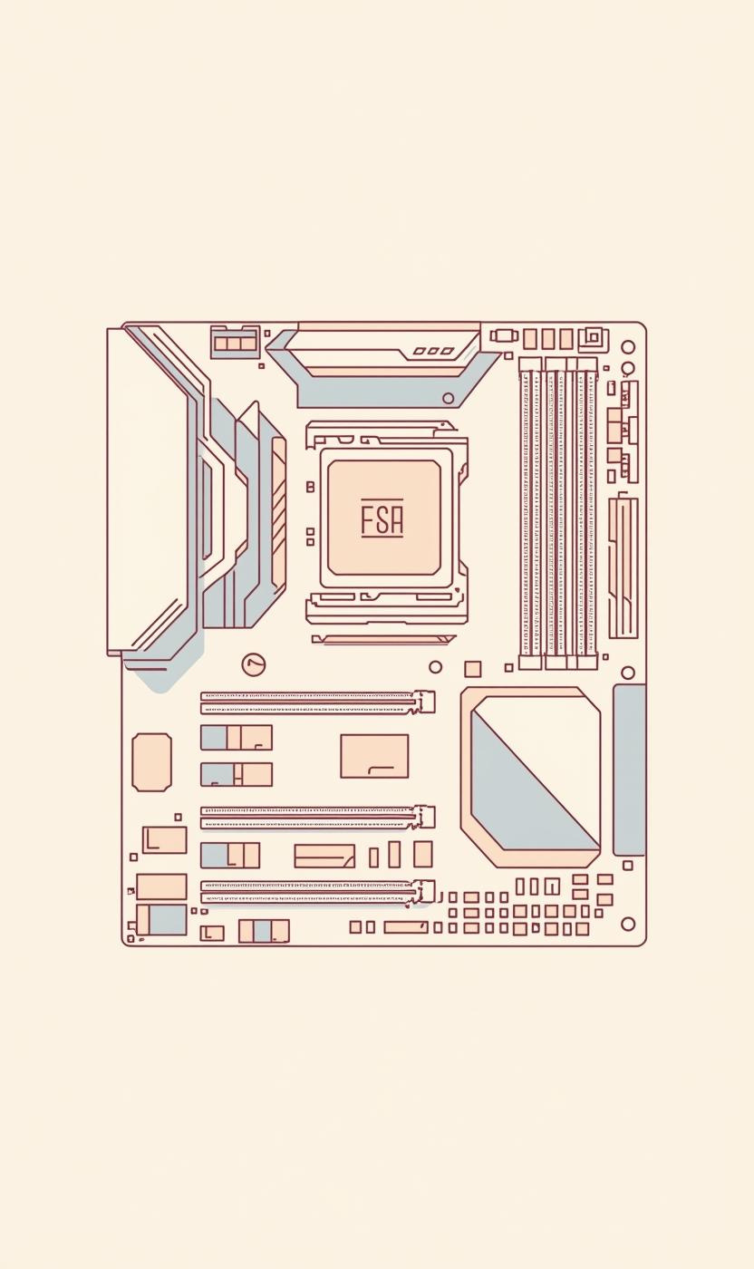
System Software: Managing Computer Resources
CORE FUNCTIONS OF SYSTEM SOFTWARE
System software acts as a manager of hardware, ensuring all components operate smoothly while providing a platform for application execution.

Slide 5

System Software Functions
CPU CONTROL
MEMORY MANAGEMENT
STORAGE MANAGEMENT
System software regulates CPU operations, coordinating tasks between hardware and applications, ensuring smooth execution of processes and efficient resource allocation.
It manages system memory usage, allocating space for applications and data, optimizing performance through efficient memory allocation and retrieval processes.
System software organizes data storage, facilitating file management and device interactions, ensuring data integrity and accessibility across various storage devices.

Slide 6
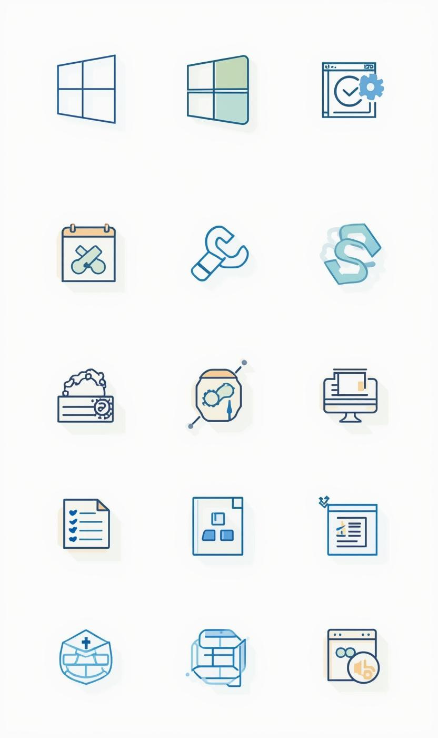
Examples of System Software Types
OPERATING SYSTEMS AND UTILITIES
System software includes operating systems like Windows, utility programs for maintenance, and device drivers that facilitate hardware interaction.

Slide 7
Application Software Overview
PURPOSE
TYPES
EXAMPLES
Application software serves to perform specific tasks, enhancing user productivity and experience while not being essential for computer functionality.
Various types of application software exist, including productivity tools, multimedia applications, and educational software, catering to diverse user needs and preferences.
Common examples include word processors like Microsoft Word, web browsers like Google Chrome, and graphic design tools like Adobe Photoshop, all serving unique purposes.

Slide 8
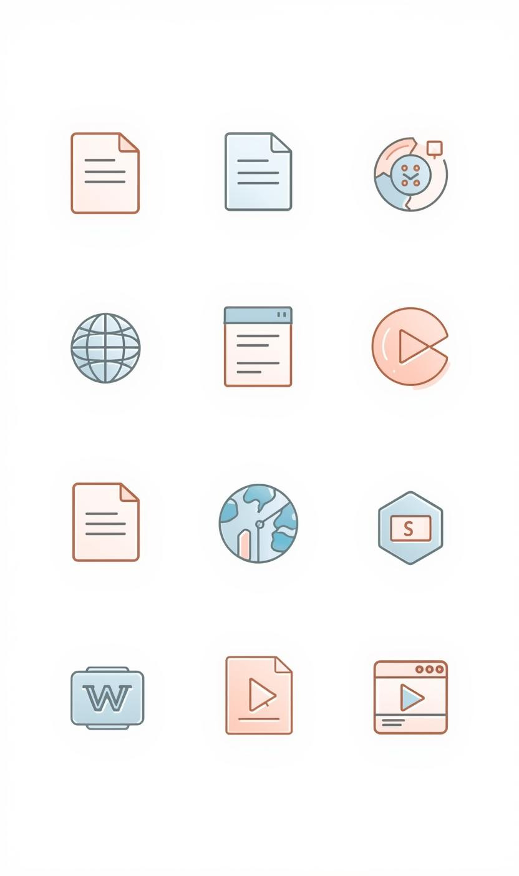
Application Software Examples: Tools for Users
TYPES OF APPLICATION SOFTWARE
Application software includes tools like word processors, web browsers, and multimedia apps, enabling users to accomplish specific tasks effectively and efficiently.

Slide 9
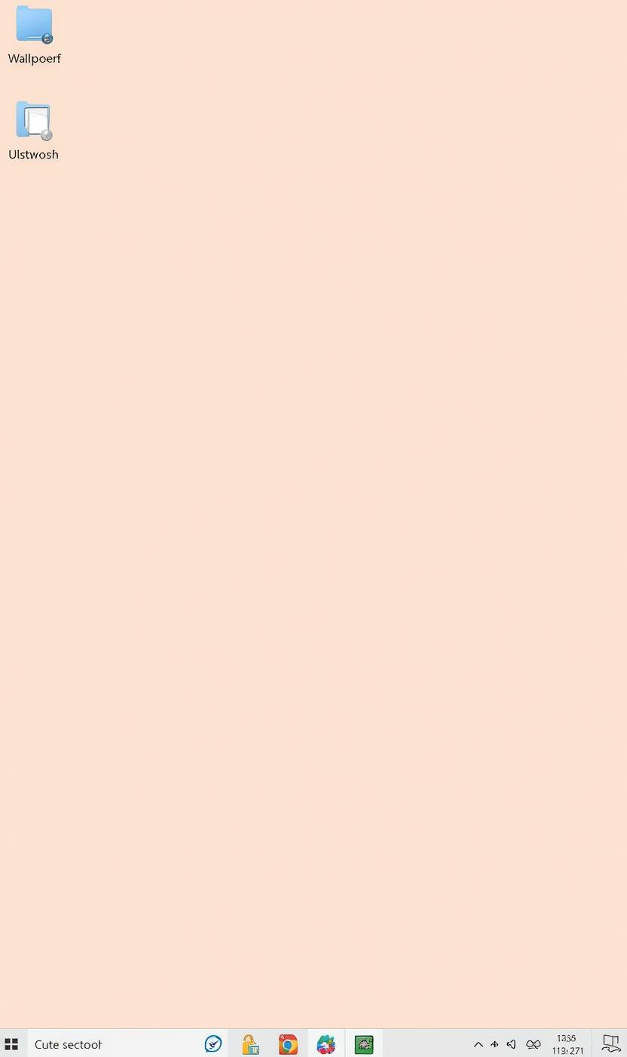
The Essential Role of Operating Systems
MANAGING HARDWARE EFFICIENTLY
Operating systems are vital for managing hardware and software interactions, providing a user-friendly interface for effective system navigation and control.

Slide 10
Operating System Examples
WINDOWS
MACOS
LINUX
Windows is the most widely used operating system, known for its user-friendly interface and compatibility with a vast array of software.
macOS, developed by Apple, is praised for its sleek design and seamless integration with Apple hardware, providing a smooth user experience.
Linux is an open-source operating system, favored by developers for its flexibility and security, offering various distributions tailored to different needs.

Slide 11
Windows Desktop Overview
ICONS
SHORTCUTS
CUSTOMIZATION
The desktop features icons representing applications, files, and folders, allowing users to access frequently used items quickly and efficiently.
Shortcuts provide convenient access to programs and files, enabling users to launch applications directly from the desktop without navigating through menus.
Users can personalize their desktop experience by choosing customizable wallpaper, enhancing their workspace's look and making it more inviting and enjoyable.

Slide 12
Taskbar and Start Menu
LOCATION
NOTIFICATIONS
PROGRAM ACCESS
The taskbar is located at the bottom of the screen, providing a central area for managing applications and accessing system notifications.
The taskbar displays notifications for running applications, system updates, and alerts, keeping users informed of important events and activities.
The Start Menu offers easy access to installed programs, settings, and files, enhancing user navigation and streamlining workflow efficiency.

Slide 13


Conclusion and Further Learning

